Slide 1
Basics of preprocessing for EEG data

Slide 2
Intro
Data preprocessing is often data/ study/ lab dependent.
Overview a list of possible/ commonly used preprocessing steps for EEG data.
Different routines / programs depend on different amounts of user input/ experience.

Slide 3
Goals of preprocessing
To isolate/ remove contributions to the EEG data that are unrelated/ not generated by brain activity – maximize signal to noise
Also, possible to attenuate the signal at certain frequencies
Prepare the data for analysis

Slide 4
Overview of possible preprocessing steps
Overview of steps
1.Import and split dual EEG data.
2. High pass filter data (e.g., .5Hz)
3. Remove line noise.
4. Low pass filter.
5. Re-Reference (robust average reference).
6. Identify/ interpolate bad channels.
7. Remove bad continuous data segments.
8. Run ICA.
9. Identify and remove ‘artifactual’ ICA components.
10. Epoch data around important events

Slide 5
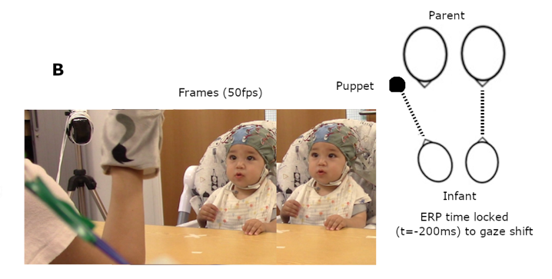
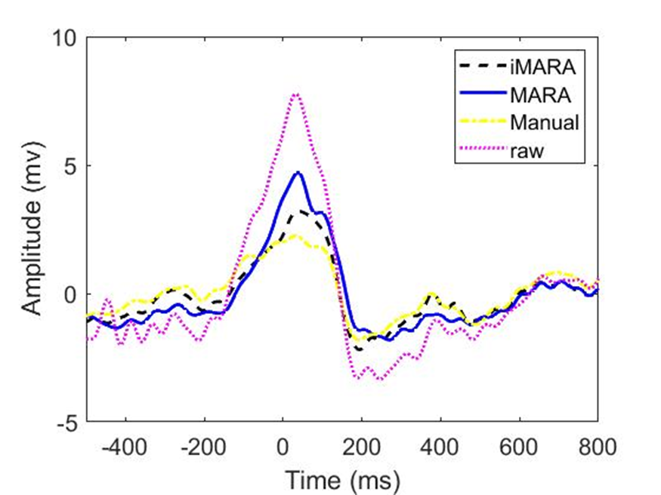
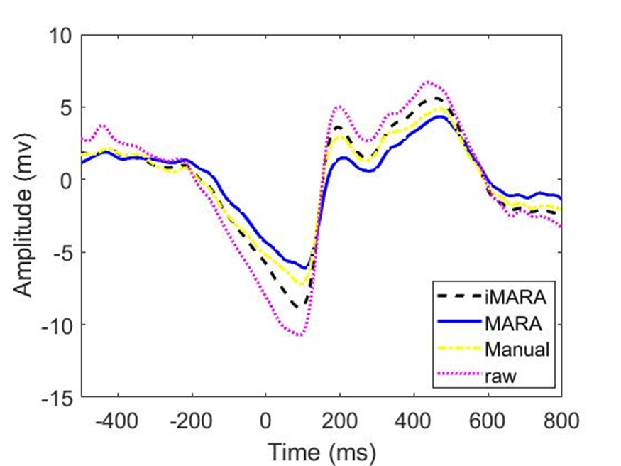
2 – during naturalistic/free viewing paradigms eye movements are time locked.
Frontal
Occipital
Problem: Compared to screen-based tasks our data is time locked to artifact e.g the movement of the eyes
Solution: More work on optimization of source separation techniques with child/infant EEG.
Notes:
The future study of IBC using naturalistic paradigms will need to control for the contributions of non-neural signal in the EEG. It may also treat this non-neural signal as a data source, by looking at synchrony between these movement-related signals, e.g., synchrony in EMG association with facial affect and vocalisations.

Slide 6
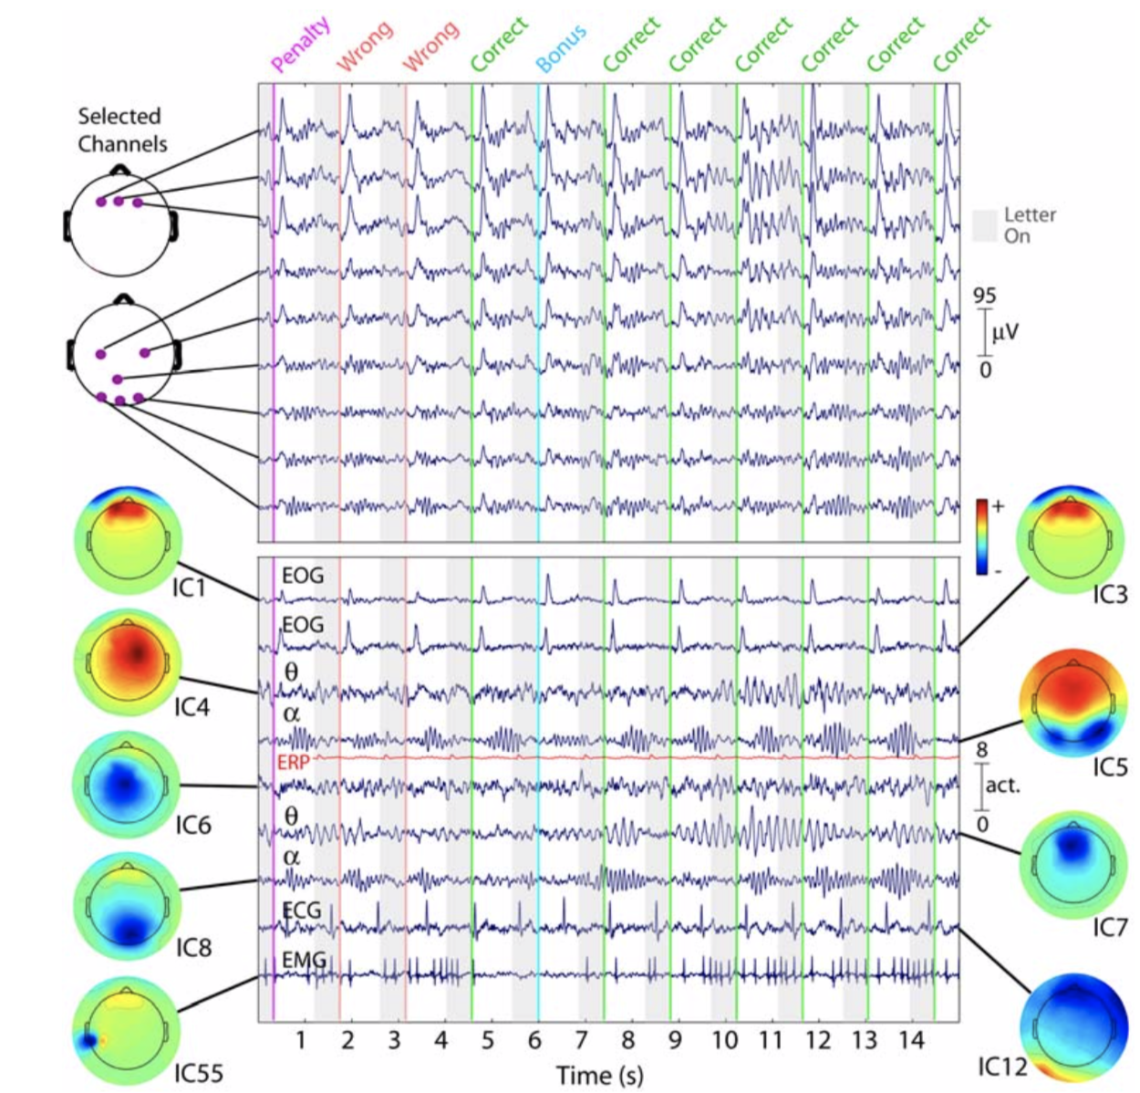
Independent components analysis
When applied to EEG data, ICA separates the contributing sources to the scalp EEG into additive subcomponents, with varying contributions to the overall signal (Rutledge and Bouveresse, 2013; Makeig et al., 1996). Each ICA component typically contains a varying mix of neural and artifactual signals.

Slide 7
Identifying and removing ‘artifactual’ ICA components.
Typically, researchers manually select which ICA component to keep/remove, based on consideration of each component’s time-frequency and topographical properties
This process can be very time consuming
Requires knowledge/ experience of what to look for Freely available systems can also automate this process
Some systems (e.g., imara) provide rapid automated identification of artifactual ICA components

